Slide 1
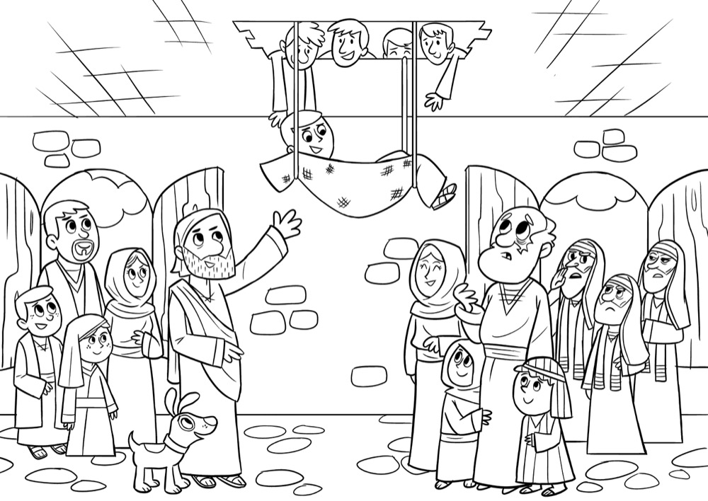
Jesus heals a paralyzed man
Luke 5:17-26
Jesus performed miracles to prove who He was. A miracle is an act of God.
Being paralyzed means that the man couldn't walk and probably couldn't use his legs. He would have had to sit or lie down all the time.
Jesus had come home to Capernaum which is on the north shore of the Sea of Galilee.
So many people came to hear Jesus teaching, there was no room left in the house or outside!
Four men, carrying their friend who was paralyzed on a mat, came to see Jesus so that he could be healed.
Jesus' first response to the paralyzed man was not to heal him, but to forgive his sins. When the Pharisees accused him of blasphemy for that, Jesus then performed the miracle of healing to show them that he had the authority both to forgive sins and to heal.
It was so busy they couldn't get their friend through the door, so they went on the roof and made an opening. They then lowered their friend down to Jesus.
These men truly demonstrated faith. They went out of their way to get this man to Jesus because they just knew that Jesus was able to do something about his situation.

Slide 2
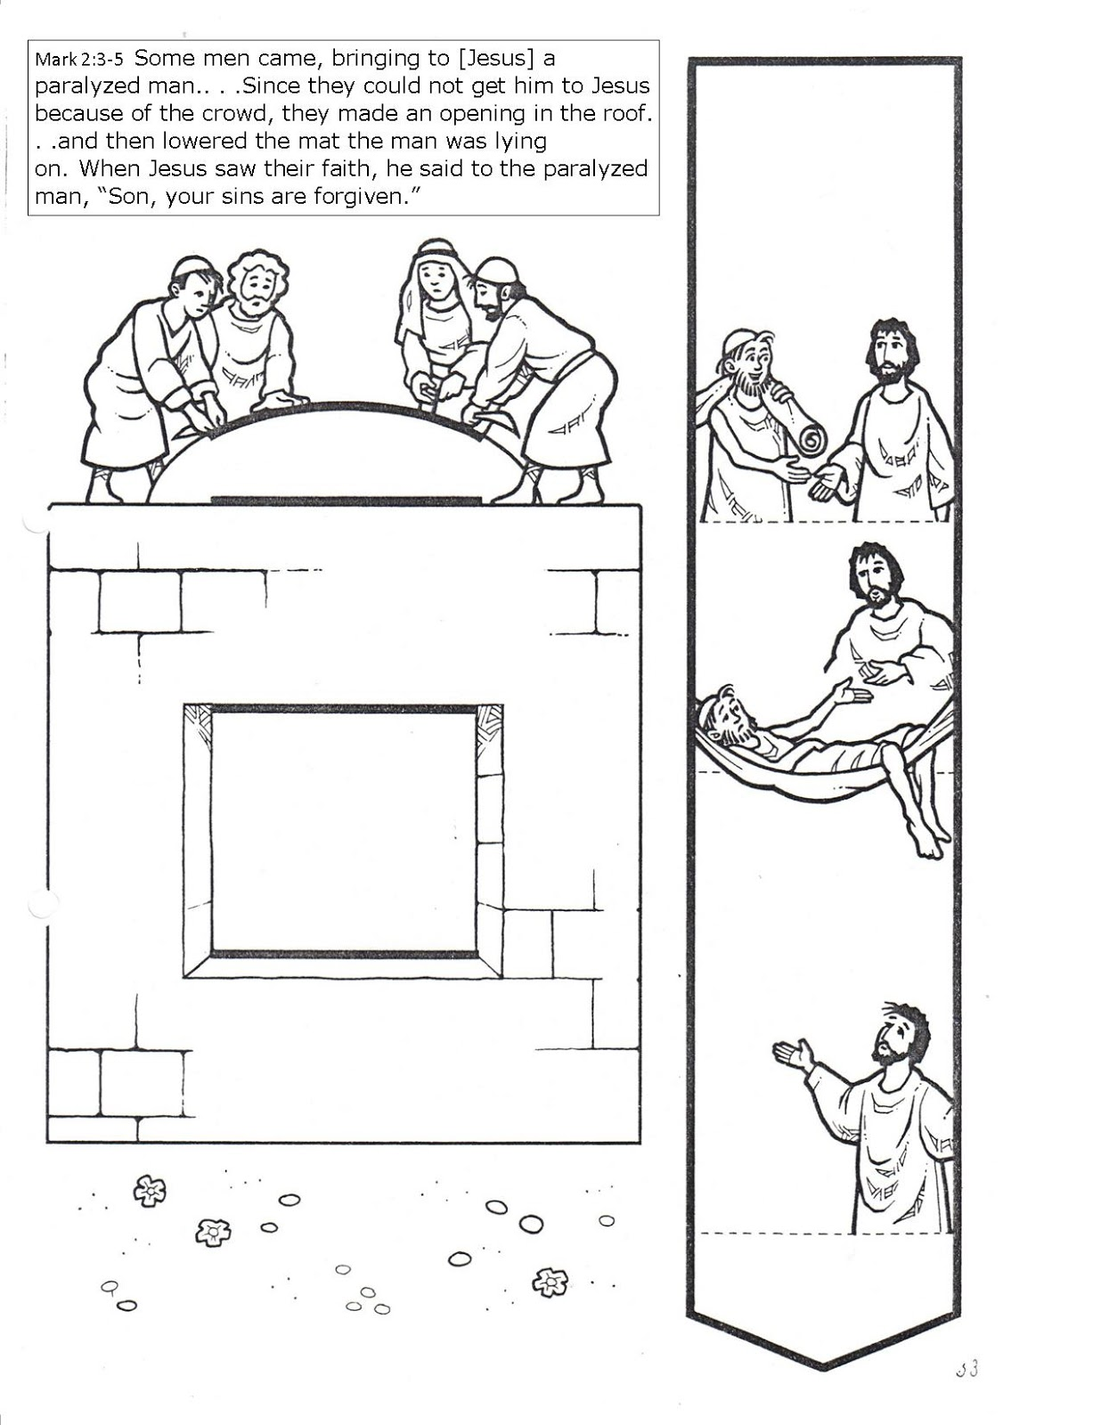
Some men came, bringing on ( Jesus) a paralyzed man...Since they could not get him to Jesus because of the crowd, they made an opening in the roof…and then lowered the mat the man was lying on. when Jesus saw their faith, he said to paralyzed man, ”son, your sins are forgiven.”

Slide 3
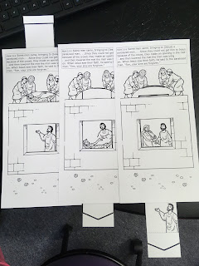
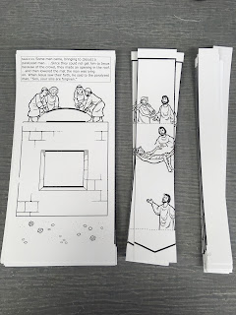
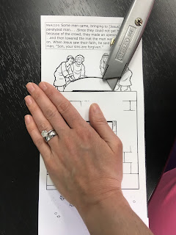
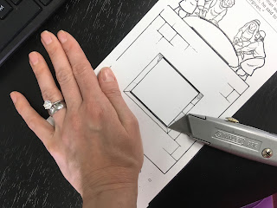
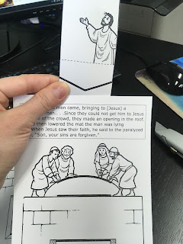
Have A Go….
Make a movable Jesus Heals a Paralyzed man story sheet
Luke 5:17-26
1. Cut the sheet as seen in picture and colour in.
2. Using Scissors cut out three slits and the window.
3. Slide the narrow card into the slit so that it moves past the window telling the story.

